Slide 1


ISBT 128 Industry Standard and Implementation Process
Overview

Slide 2
Speaker
Susan Schene, MBA, MT(ASCP)
Validation and Implementation Liaison
(405) 297-5750
sschene@obi.org

Slide 3
Purpose
To understand the issues facing hospitals as they prepare for the conversion to ISBT 128-labeled blood products.

Slide 4
Outline
What is ISBT?
Why change to ISBT 128?
Highlights of ISBT changes
More detail about the changes
Other changes taking place
Assess organizational impact
How should hospitals plan for conversion?
Additional references

Slide 5
What is ISBT?
International
Society of
Blood
Transfusion
Utilizing code 128

Slide 6
Why change to ISBT 128?
AABB requirement by May 2008
All major blood centers will convert

Slide 7
Why change to ISBT 128?
Limitations of Codabar
  Codabar is susceptible to scan errors
  Product code structure is not updated to reflect proliferation of new blood products
  No provision to maintain the system

Slide 8
Highlights of ISBT 128 Changes
Appearance of the label
  Layout will be different than current label
  Globally consistent appearance
Different bar code technology
  From ABC Codabar to ISBT 128 symbology
  Globally consistent bar code symbology
Structure of blood unit number (BUI)
  13 digits instead of 7
  Globally unique number

Slide 9
Highlights of ISBT Changes
Product code
  From 5 digits to 8 digits
  From 100 product codes to 4000+
  Globally consistent product codes
Expiration date
  May show the time of expiration
  Globally consistent expiration dating

Slide 10
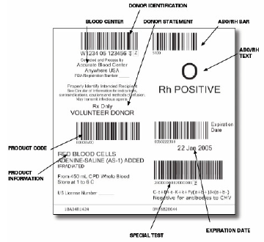
More Detail About the Changes
Full Face Label

Slide 11
Blood Unit Identification Number
W0910 06 123456
00
Y
Country Code
Four digit center code
Year
Serial Number (formerly BUI number)
Flag character
Check character

Slide 12
More Detail About the Changes
Product codes
  Globally recognized
  4000+ ISBT 128 product codes
  8-digit product code represents
    Product class (RBC, plasma)
    Modifiers (washed, frozen)
    Additional information (irradiated)
    Donation type
    Divided unit status (first division, second division)

Slide 13
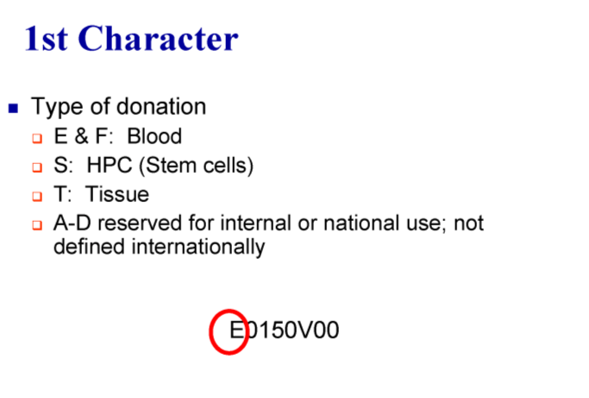

Slide 14
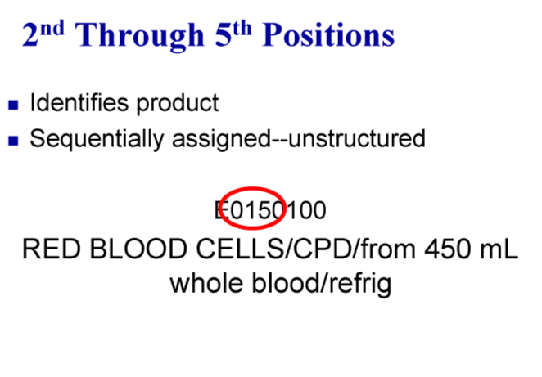

Slide 15
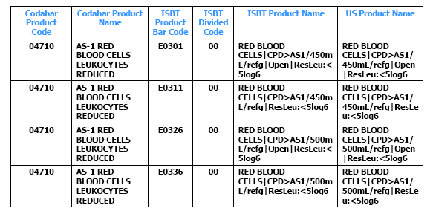
More Detail About the Changes
Comparison of Codabar to ISBT 128 Product Codes

Slide 16
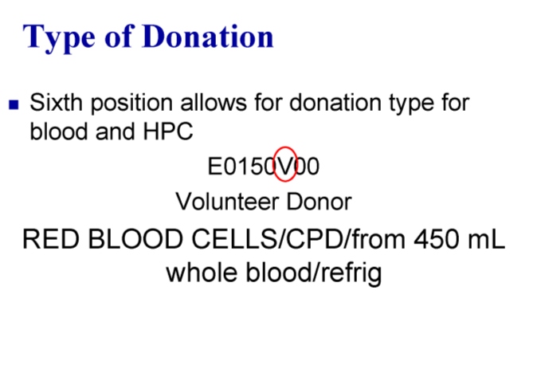

Slide 17
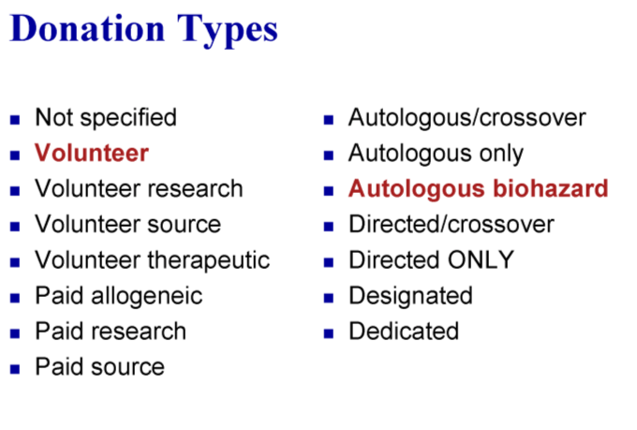

Slide 18
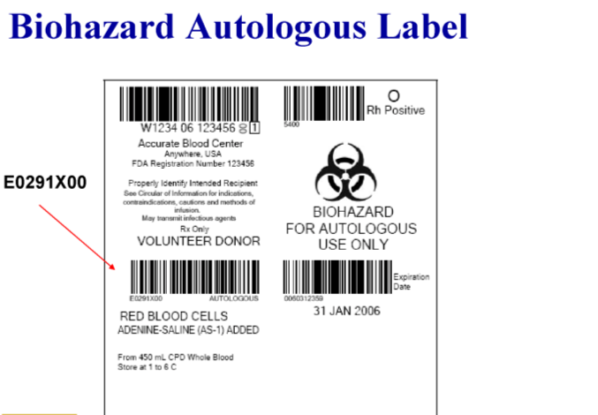

Slide 19
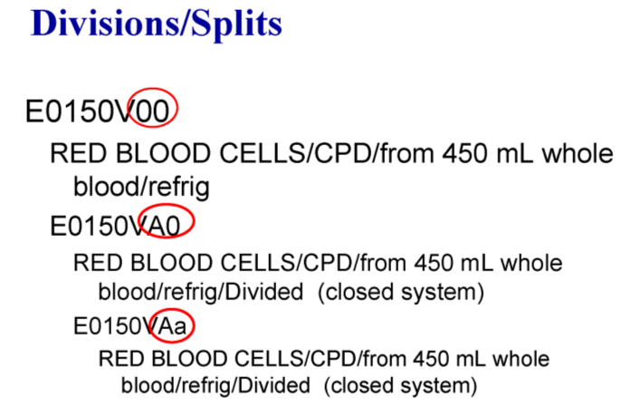

Slide 20
Flag Characters
00
W0910 06 123456
Y
Used in process control
Should not be recorded as part of the BUI number in facility records
The flag characters are non-data characters.They are used to convey specific information other than the unique identification of the blood product.

Slide 21
Flag Characters
00
W0910 06 123456
Y
Used to identify bags (Container 1, 2, 3, etc.), tubes (EDTA, clot, NAT, etc.), donor record label
May be icons

Slide 22
Check Character
W0910 06 123456
00
Y
Not a part of the BUI
Not in the bar code because it’s meant to check KEYBOARD entry
May want to record in manually written records
Will create an error message if there are any errors in data entry

Slide 23
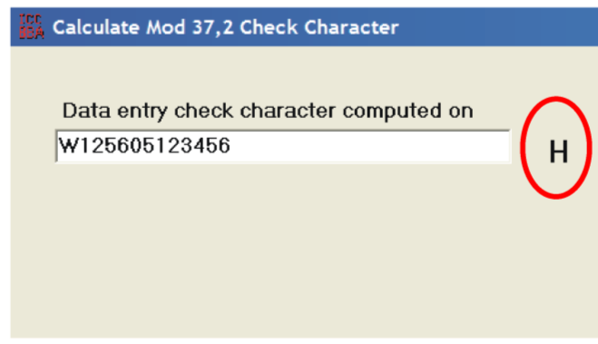
Check character
Look up table on the ICCBBA web page (http://iccbba.org/tech_tools.html)
Quick K calculator

Slide 24
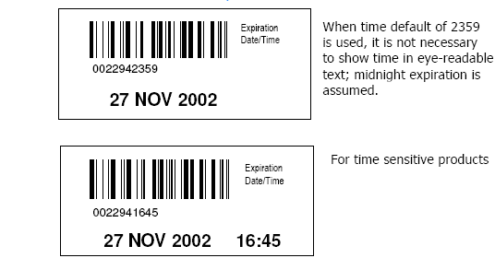
More Detail About the Changes
Expiration Labels

Slide 25
Other Changes Taking Place
21 CFR 606.121(c)(13) states the following information on labels must be machine readable as well as eye-readable after 4/26/2006
  Includes aliquoting, pooling, or relabeling
    Unique facility ID
    BUI number
    Product Code
    ABO/Rh
  Does not include expiration dates
  Does not differentiate between Codabar and ISBT 128

Slide 26
Other Changes Taking Place
AABB regulations
  Have written plan for conversion by November 2006
  Implement ISBT 128 by May 2008

Slide 27
Other Changes Taking Place
ICCBBA
  Who are they?
    Formerly known as International Council on Commonality in Blood Banking Automation. Today, they are known by their acronym.
  What do they do?
    Responsible for worldwide administration
    Maintain databases of product codes, locations
    Assign site registration numbers
    Host technical advisory groups

Slide 28
Assess Organizational Impact
Software impact
  Computer systems
    Blood bank system, lab system, billing system
    Ensure computer can read, translate, store, and process ISBT 128 data
      13 character BUI
      8 character product code
      Expiration time and date
    Computer must read both Codabar and ISBT 128

Slide 29
Assess Organizational Impact
Software impact
  Computer interfaces and interfaced systems
    Ensure interfaces and interfaced systems can manage data
      Billing systems
      Lab equipment
      Viral marker testing transfers
      Reports (workload, operational, statistics)
Even hospitals without computer systems will be impacted

Slide 30
Assess Organizational Impact
Procedure and forms impact:
  Review procedures
    Will ISBT 128 changes require modifications?
  Review forms
    Accommodate 13 character BUI?
    Accommodate 8 character product code?

Slide 31
Assess Organizational Impact
Staff training impact:
  Blood bank staff
  Transfusion staff
  Floor staff
  OR staff
  Accounting/billing
  Anyone who touches blood products
  Anyone who scans blood product bar codes

Slide 32
Assess Organizational Impact
Equipment impact
  Ensure equipment can read ISBT 128 bar codes
    Scanners
    Printers
    On-demand label printers
    Lab equipment i.e. Hematology, microbiology, chemistry
Validation impact
  Consider any changes to hardware, software, and equipment
  Processes may need validation
    Aliquots, pools, modifications
    SOP’s

Slide 33
Assess Organizational Impact
Financial impact
  Software development cost
  Upgrade/replace on-demand label printers
  Upgrade/replace bar code scanners
Product impact
  Both Codabar and ISBT 128-labeled products will be shipped to hospitals
  Codabar products with extended dates in inventory
    Frozen products

Slide 34
How should hospitals plan for conversion?
Establish a committee of stakeholders
Determine anticipated conversion date
Develop a plan
  AABB members must have written plan by November 2006
  AABB and ICCBBA have example plans
  A web search will identify example plans

Slide 35
How should hospitals plan for conversion?
Develop a budget
Create a project management plan listing specific tasks, responsible people, and timeframes for completion
  Work back from an anticipated conversion date

Slide 36
How should hospitals plan for conversion?
Develop a communication plan
  Notify management
    Medical director/pathologist
    Hospital administrator
    IT manager
  Notify other hospital departments
    Impacted departments
      Nursing, dialysis, anesthesiologists
      Anyone who touches a blood bag
    Impacted laboratories
      Microbiology, chemistry, hematology
      Anybody who scans an ISBT 128 bar code

Slide 37
Additional References
AABB
  Sample ISBT 128 implementation plan
  www.aabb.org/members_only/archives/other/isbt128plan.htm
FDA
  http://www.fda.gov/cber/gdlns/ISBT128Nov99.pdf

